Slide 1
Rational Developer for System z – Distance Learning Setup
Module 1 – Installing and configuring RDz Workstation Client V9.0 and IBM Data Studio 4.1
Jon Sayles, IBM Rational

Slide 2
IBM Trademarks and Copyrights
  © Copyright IBM Corporation 2009, 2010, 2011, 202, 2013. All rights reserved.
  The information contained in these materials is provided for informational purposes only, and is provided AS IS without warranty of any kind, express or implied. IBM shall not be responsible for any damages arising out of the use of, or otherwise related to, these materials. Nothing contained in these materials is intended to, nor shall have the effect of, creating any warranties or representations from IBM or its suppliers or licensors, or altering the terms and conditions of the applicable license agreement governing the use of IBM software. References in these materials to IBM products, programs, or services do not imply that they will be available in all countries in which IBM operates.
  This information is based on current IBM product plans and strategy, which are subject to change by IBM without notice. Product release dates and/or capabilities referenced in these materials may change at any time at IBM’s sole discretion based on market opportunities or other factors, and are not intended to be a commitment to future product or feature availability in any way.
  IBM, the IBM logo, the on-demand business logo, Rational, the Rational logo, and other IBM Rational products and services are trademarks or registered trademarks of the International Business Machines Corporation, in the United States, other countries or both. Other company, product, or service names may be trademarks or service marks of others.

Slide 3

Course Contributing Authors
Thanks to the following individuals, for assisting with this course:
  Bill Klein
  Stephen F. Heffner, President of Pennington Systems Incorporated, Scottsdale, AZ (WWW.Pennington.com)
  Wilbert Kho/IBM
  Curt Bergkvist/Handelsbanken
  Asish Toomuluru/BNSF Railway & Rick Anderson/BNSF Railway

Slide 4
Course Outline
Course Name: Rational Developer for System z Foundation Training
Course Description: Learn how to use Rational Developer for System z to do z/OS traditional development, maintenance, support and for Enterprise Modernization of z/OS applications
Pre-requisites: Some experience developing COBOL applications using z/OS is expected. A working knowledge of SQL is also recommended.
Course Length: ~5days (10 hours) – or if done in self-paced mode, at your own pace
Topics (Agenda)
    Getting Started - installing and configuring RDz - and the course materials, and using Eclipse
    The RDz Workbench
      Code analysis tools
      Editing
      Compiling programs
      Debugging local COBOL programs
    The Data Perspective:
      Working with relational data sources
      Modifying test data
      Editing and testing SQL statements
    Working with remote system resources:
      Connecting to a mainframe
      Data management
      Accessing and editing files
    z/OS Application Development
      Creating MVS Subprojects
      Creating and customizing project properties
    Debugging z/OS Applications
      Debugging Batch Applications
      Setting Debug Tool for Online Applications

Slide 5
Course Details
Audience
  This course is designed for application developers who have learned or programmed in a 3rd or 4th generation language – and who need to build leading-edge applications using COBOL and Rational Developer for System z.
Prerequisites
  This course assumes that the student has a basic understanding and knowledge of software computing technologies, and general data processing terms, concepts and vocabulary.
  Knowledge of SQL (Structured Query Language) for database access is assumed as well – for certain sections of the course (that will be noted)
  Basic PC and mouse-driven development skills is also assumed
  If you don't have z/OS-mainframe experience there is an optional unit on this

Slide 6

Course Objectives
At the end of this course, you will be able to:
  Create COBOL programs that do batch processing using sequential files (QSAM)
  Understand and use the majority of IBM Enterprise COBOL statements
  Use the development facilities of Rational Developer for System z for:
    Editing
    Compiling
    Debugging
  Understand enough of mainframe JCL to run programs on host systems
  Describe the coding for COBOL programs that:
    Do IMS database (DL/I) and Transaction Manager calls
    Call through CICS command level COBOL
    Read and Write VSAM indexed files
    Access XML
    Can be accessed as Web Services in a Service Oriented Architecture
    Can be accessed via Web 2.0 applications

Slide 7
RDz and Course Setup
UNIT
Topics:
How to take this course
Installing RDz and Setting up for the course
Installing IBM Data Studio for the course (Optional)
Install Verification Procedure
Accessing your Mainframe resources
About Rational Developer for System z

Slide 8
Topic objectives
After completing this topic, you should be able to:
  Describe how to use these course materials
  Differentiate between the two types of slide topics in the learning modules
  Navigate to additional learning resources for both:
      RDz
      COBOL

Slide 9
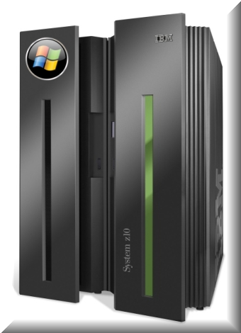
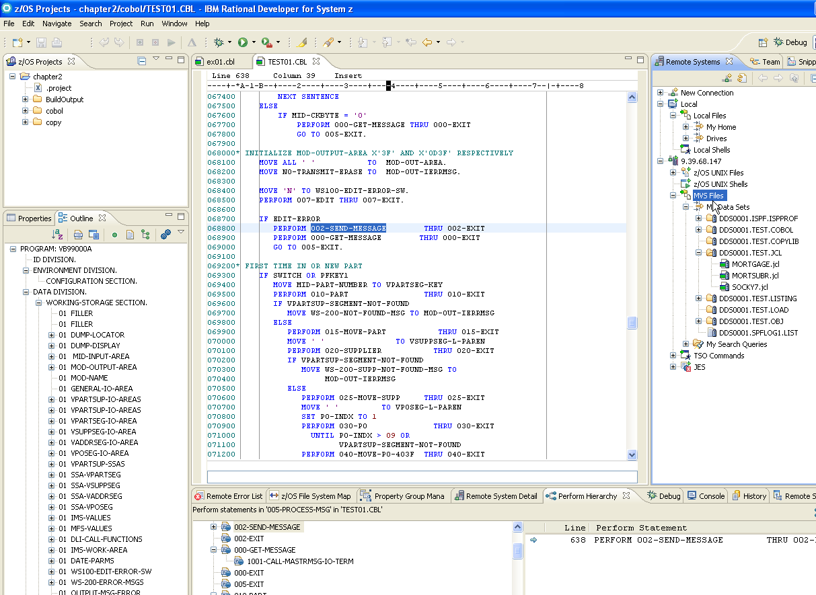
Welcome to Enterprise COBOL and Rational Developer for System z
COBOL runs the worlds' enterprises
RDz is the way we make COBOL development easy
IBM z/10
Rational Developer for System z

Slide 10
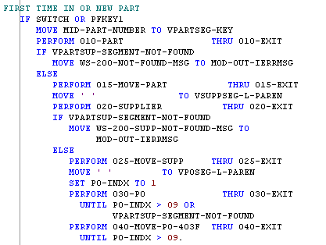

Why COBOL?
Let's look at some numbers…
COBOL applications:
  Process 70% of the world's data
    In finance and insurance over 95%
    60% of all Web-access data resides on a mainframe
  Run over 30,000,000,000 transactions daily
    83% of the transactions worldwide
  Are in production at over 98% of the Fortune 500
    Including the entire Fortune 100
Well over 220,000,000 lines of COBOL running in production world-wide
  > 5,000,000 lines of new COBOL added each year
  All these programs will have to be maintained, supported and enhanced.
There will be a continuing demand for COBOL programmers with about
  70% of the work in the form of maintenance
  30% in the form of enhancements and new development
  New applications – in other languages such as Java – are going to have to co-exist with the existing base of COBOL applications
COBOL

Slide 11
Why RDz?
RDz is IBM's Workbench for developing COBOL in the 2000's
It features a set of high-end, cross-platform graphical tools, that makes as simple as possible:
  Traditional COBOL Development:
    Setting up projects:
      COBOL Batch
      Online projects:
        CICS
        IMS TM
      File and database projects: DB2, QSAM, VSAM, IMS DL/I
    Editing your COBOL source
    Compiling
    Testing - On the mainframe, as well as on your workstation
    Connecting to the mainframe
      Submitting jobs and managing them
    Analyzing and maintaining COBOL applications
    Debugging mainframe ABENDs (defects) and logic errors
  Leading-edge COBOL Development:
    Developing Web and Web 2.0 front-ends to CICS and IMS TM (Transaction Management) applications
    Transforming CICS and IMS applications into Web Services in a Service Oriented Architecture
    Doing XML/COBOL applications
    Working with MQ (Message Queue)
    Connecting to COBOL business applications from Java and .NET applications
    Creating stand-alone Windows applications (.exe files)

Slide 12
How to Use These Course Materials
This course has two different modes of educational delivery – each based on both content matter and effective knowledge transfer:
  Read and Learn: 
  Do and Acquire Skills: 
Notes:
 Notes:

Slide 13
Read and Learn
 Read and learn is the most prevalent form of education presented in this course.
  From the slides you are viewing, you can read and understand concepts about RDz and COBOL. This is static information presented as traditional text and graphics.
  Occasionally a slide will have a double-right-pointed triangle in the header:  This means you should do or try something on your computer.
  The Notes (at the bottom of many slides) present additional information on each concept. The Notes also present (wherever relevant) Java and .NET.
  There are numerous slides that allow you to test your knowledge and learning. These slides contain paper/pencil questions. The answers to most of these questions are at the end of the PowerPoint slides.

Slide 14

How to Use This book
 Do and Acquire
  To make all of the pieces of information covered in this course yours – and to convince you that you’ve got the skills to match the knowledge you accumulate, you will need to use RDz and COBOL to create software functionality.
  There are lots of workshops and labs throughout this course, that will allow you to discover, practice and master the RDz functionality and development techniques used to create no-compromise, production-worthy applications.
  All of the “do this” steps have a consistent icon to the left of them: 
  When you see this  symbol either at the top of a page, or at the beginning of a step, it signifies that you are to “do” something with the product or language.

Slide 15
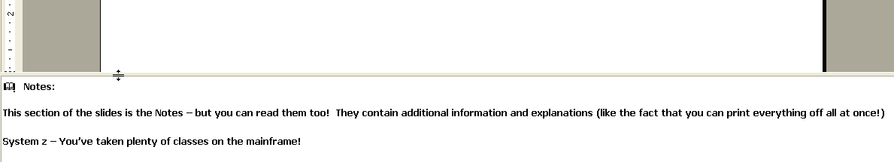
 View the Slide Notes
 Using your mouse, expand the Notes at the bottom of this slide and read them.
Adjust the size of the slides or notes to suit your viewing

Figure 1 – PowerPoint Notes View
Notes:
  Notes:
This section of the slides is the Notes – but you can read them too! They contain additional information and explanations (like the fact that you can print everything off all at once!)
System z – You’ve taken plenty of classes on the mainframe!

Slide 16

 Learn More!
There are a large number of excellent sources for background information
available online. Here are a few we use a lot:
http://www.murach.com/books/mcb2/index.htm - the COBOL reference text book we'll be using for the course. A standard for 1,000,000's of COBOL programmers world-wide
** http://www-949.ibm.com/software/rational/cafe/community/cobol - the official IBM COBOL community site, where you can ask questions, get answers, and learn about all-things-COBOL
** http://publib.boulder.ibm.com/infocenter/zos/basics/index.jsp - an excellent treatise on everything-mainframe
http://www-03.ibm.com/systems/z/destinationz/ - another IBM site for mainframes – more about the hardware, but good quality, free-content
The IBM COBOL “home page” http://www-01.ibm.com/software/awdtools/cobol/
The IBM COBOL for Windows manuals (LRM and PG)
http://publibfp.boulder.ibm.com/epubs/pdf/igy7lr10.pdf
The Enterprise COBOL V4.1 Bookshelf: http://publibfp.boulder.ibm.com/cgi-bin/bookmgr/Shelves/igy3sh40
** Definitely bookmark these sites!
Notes:
 Notes: Depending on your experience, gaining knowledge in leading-edge development subjects and topics can be crucial to the success of your projects. Do not spin your wheels wondering about a given concept, term, new vocab, etc. Look it up!!

Slide 17
RDz Workstation Product and Course Setup
UNIT
Topics:
How to take this course
Installing RDz and Setting up for the Course
Installing IBM Data Studio for the course (Optional)
Install Verification Procedure
Accessing your Mainframe resources
About Rational Developer for System z

Slide 18
Topic objectives
After completing this topic, you should be able to:
  Successfully install and configure RDz
  Successfully install the RDz education example files for this class
  Run the Installation Verification Program – and see running COBOL modules that ensure your setup is successfully complete, and you’re ready to begin learning
 Important Notes
  If you already have RDz installed on your workstation you can skip this section, and go to the section in these slides named, Install Verification Procedure
  You will need “Admin Rights” on your workstation
  System Requirements for RDz Installation:
    Windows XP or later
    10 gigs of available disk space
      Some of which will be given back after temp-installation files are deleted
    4 gigs of RAM
  If you want to integrate IBM Data Studio 4.1 client with RDz you will; 1. Download and install RDz v9 (this section) then; 2. Download and install IBM Data Studio v4.1 (next section) and have them “shell-share” – meaning install share-able components into the same directory structure.

Slide 19
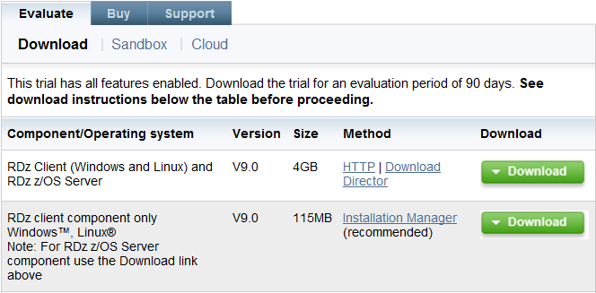
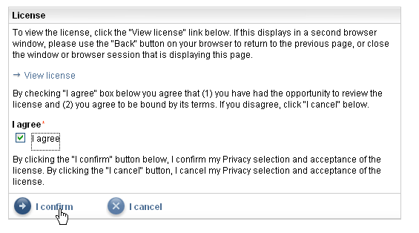
 RDz Installation Process – 1 of 12
Open a browser, and point it at:
    http://www.ibm.com/developerworks/downloads/r/rdz/
    From the Evaluate tab – click: Download
  At the Rational Developer for System z Trial page, you will either have to:
    Login to IBM's DeveloperWorks …or… Register for IBM DeveloperWorks, and then login
  When you have logged in, you will see a summary page, where you'll have enter a few additional pieces of information about your interest in RDz – and privacy settings.
  You'll have to accept the license agreement
  Click I confirm to continue
Use IBM Installation Manager
Note: If you’re using Internet Explorer (I.E.) and having difficulty navigating try using Firefox or Chrome

Slide 20
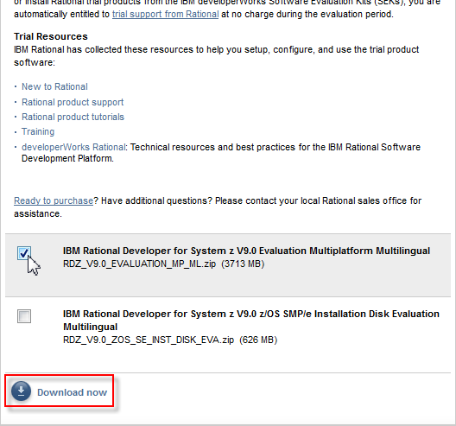
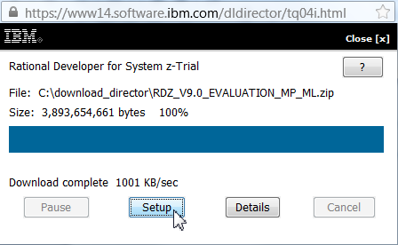
 Installation Process – 2 of 12
From the next web page:
Scroll and select Windows
Click Download now
After the download is complete click Setup

Slide 21
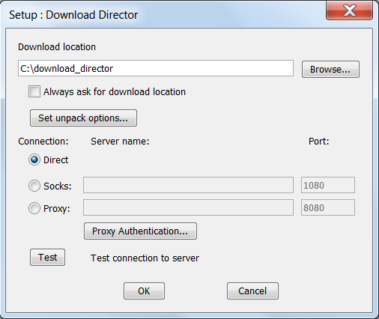
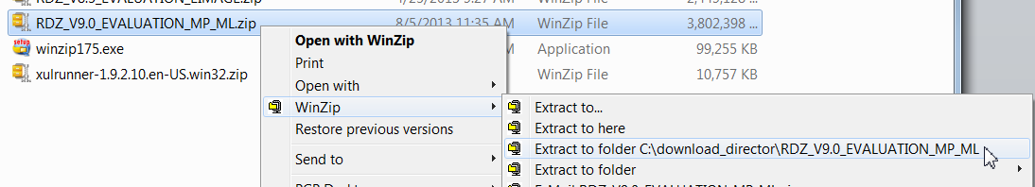
 Installation Process – 3 of 12
Setup prompts you for an download directory
… a place to store a .zip file
The default directory for Rational products is:
C:\download_director
From the downlad directory you chose, unzip the contents of:
RDZ_V9.0_EVALUATION_MP_ML.zip
to some location

Slide 22
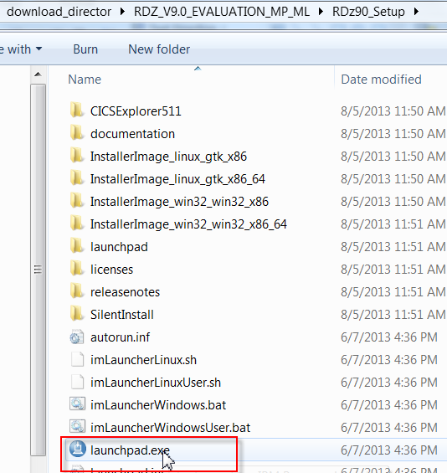
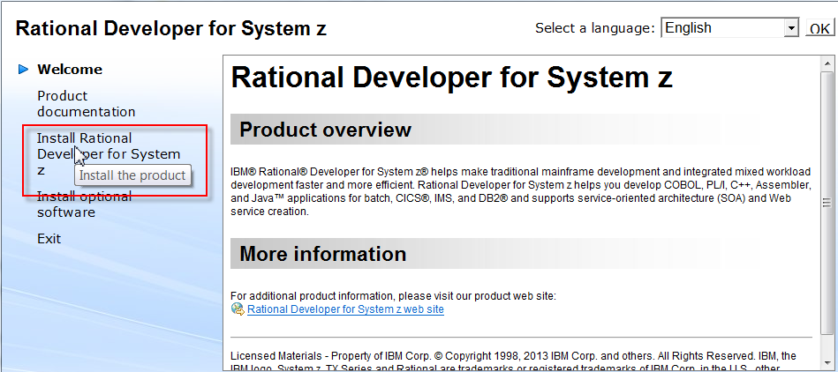
 Installation Process – 4 of 12
Open the folder named: RDz90_Setup inside of the download directory and click: launchpad.exe
From the Welcome tool bar, click:
Install Rational Developer for System z

Slide 23
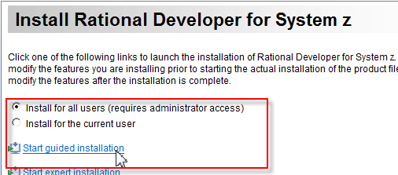
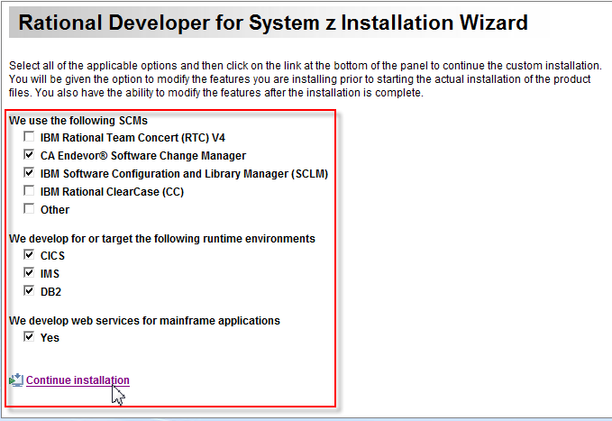
 Installation Process – 5 of 12
The wizard-driven installation process asks you to answer a number of questions about customizing your RDz install – such as selecting installation features.
Please check only the following options:
Note that You may be prompted for your Windows Admin password

Slide 24
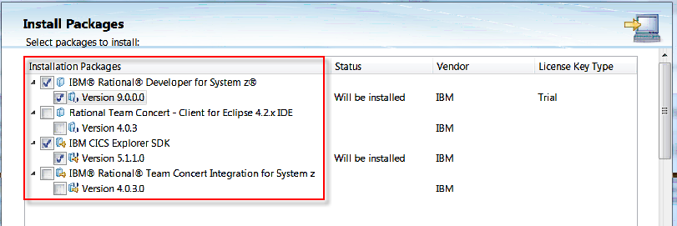
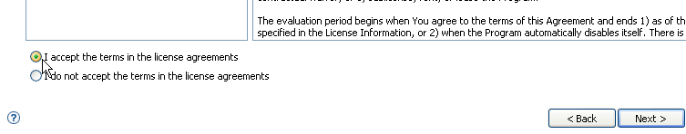
 Installation Process – 6 of 12
From Install Packages
  Make sure (at least) the IBM Rational® Developer for System z ® and Version 9.0.0.0 boxes are checked
  Click Next >
You will be asked to accept the terms of the license agreements
  Do so
  Click Next >

Slide 25
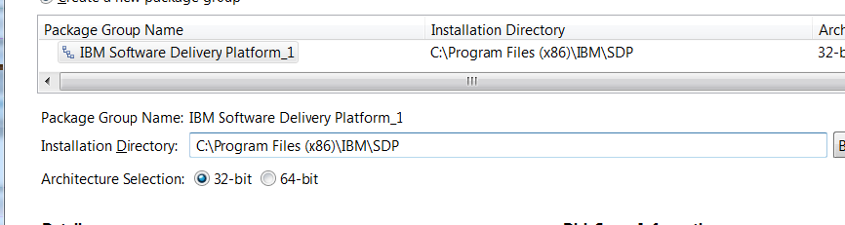
 Installation Process – 7 of 12
You will need to designate two directories for the installed software - "Shared Resources" directory – where other IBM Rational products install into, and a Package Group directory, for the unique files needed for RDz
  We recommend placing the files in separate areas of your hard-drive
  Note also that, if you are using Win7 you will have to choose 32-bit or 64-bit installation.
    For the purposes of this class it doesn’t matter
    For your production rollout it very much matters. However, most likely the decision on where to install will have been made by someone in I/T administration
Specify (or Browse to) an Installation Directory on your workstation 
Click: Next >

Slide 26
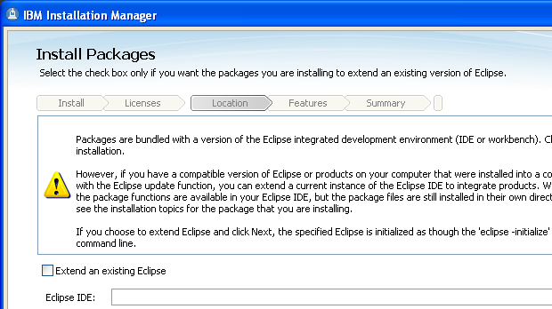
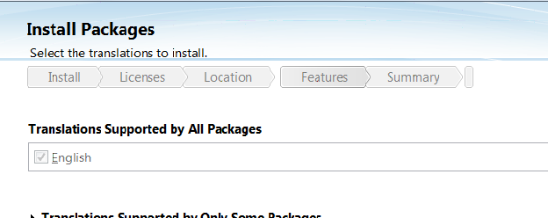
 Installation Process – 8 of 12
Click Next > at the extending Eclipse IDE wizard
  Note – unless you are an experienced Java/Eclipse developer and wish to "shell-share"
Choose your Workbench language
Click Next >

Slide 27
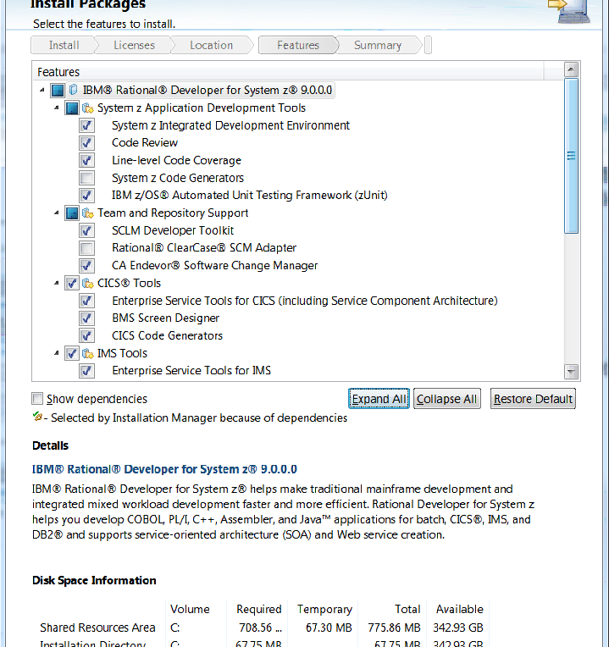
 Installation Process – 9 of 12
At this point in the wizard you can select more (lower-level) specific product features to install.
These are the defaults ➔
… and they’ll work fine for the Distance Learning class
Note that CA Endevor is optional for this class
Click Next >

Slide 28
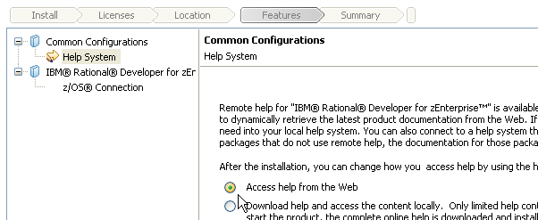
 Installation Process – 10 of 12
You can choose to install the product’s HELP system
  On your local machine
  Accessed via the web – If you choose this option the "footprint" – product installation size is smaller, but in order to get help on a topic you must be connected to the web.
  Accessed from a corporate server – in which case you must specify the server location
Choose:  Access help from the Web
Click Next >

Slide 29
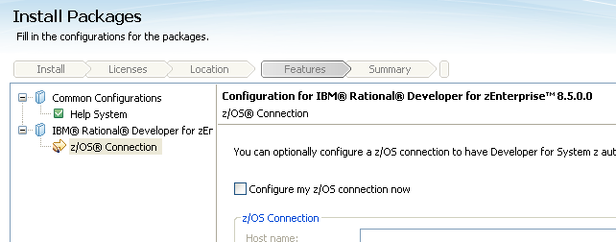
 Installation Process – 11 of 12
At the z/OS Connection configuration Feature,
  Do not check: Configure my z/OS connection now
  Click: Next >
We will configure the connection to your mainframe later in the course

Slide 30
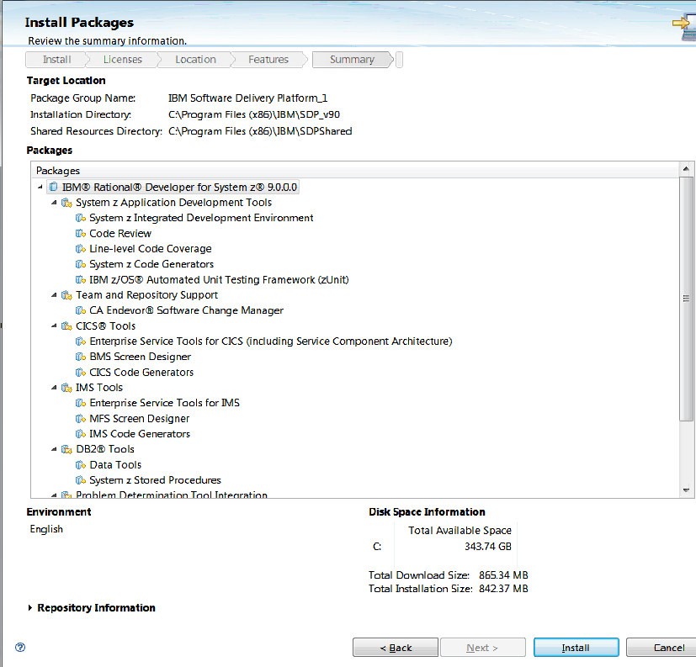

 Installation Process – 12 of 12
At this summary page
Click Install
The install will take up to an hour (depending on your PC's processor and disk read/write speed)
When installation is finished close the wizard and verify the installation by starting RDz – and following the steps on the slides in the next section.
Finally, we recommend that make a copy of the launch icon on your desktop

Slide 31
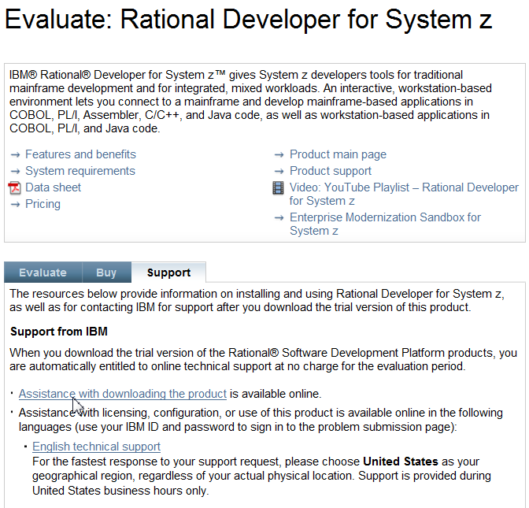
Problems with the installation?
If you had difficulty with the trial installation, please go here:
  http://www.ibm.com/developerworks/downloads/r/rdz/support.html
  … where you can obtain technical support from IBM
If you are installing the product using your own in-house licenses please consult your internal RDz administration and support team

Slide 32
RDz Workstation Product and Course Setup
UNIT
Topics:
How to take this course
Installing RDz and Setting up for the Course
Install Verification Procedure
Installing IBM Data Studio for the course (Optional)
Accessing your Mainframe resources
About Rational Developer for System z
You will create and test your first workstation-based COBOL project - an example project with two simple programs. In order to make sure everything's working you will:
  Create a new, example project
  Open a sample program in the editor
  Close the editor and exit RDz

Slide 33
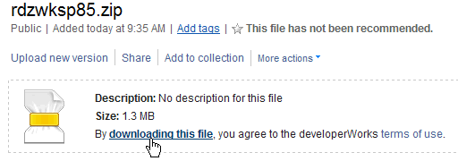
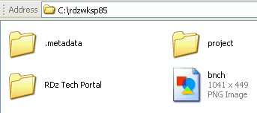
 Install Verification Procedure – 1 of 4
Download and unzip the Custom Workspace for your RDz client:
  From: https://www.ibm.com/developerworks/community/files/app/file/191c176c-ef66-452e-a1bc-2b0034cc47c2
  Download the file:
Once the file is downloaded:
Unzip it directly onto your C:\ drive
Then using My Computer verify that the unzip was successful
... You should see these folders:

Slide 34
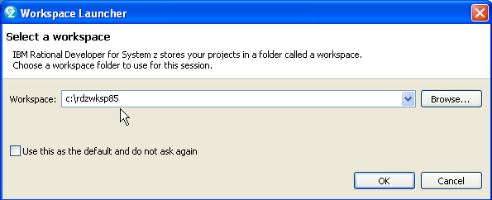
 Install Verification Procedure – 2 of 4
From your desktop or the Windows start menu launch RDz
When you are prompted for a Workspace use the Browse… function to find: C:\rdzwksp85:
This folder ➔

Slide 35
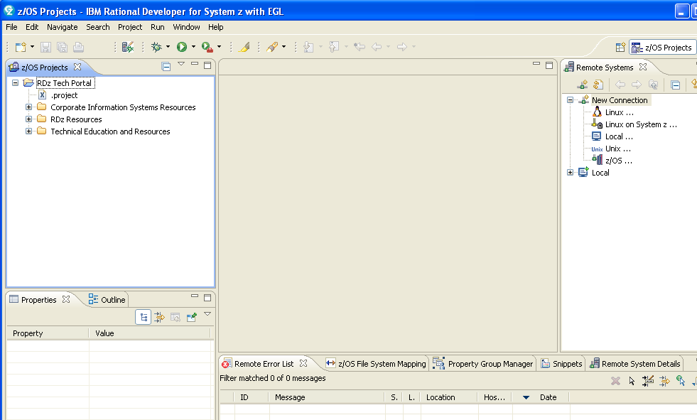
 Install Verification Procedure – 3 of 4
RDz opens in what is called the: z/OS Projects Perspective
◉ If after RDz opens, you notice a "Welcome Screen", most you likely did not unzip the custom workspace correctly. To correct this: 1. Close RDz. 2. Unzip your custom workspace directly onto the c:\ root drive. 3. Re-open RDz

Slide 36
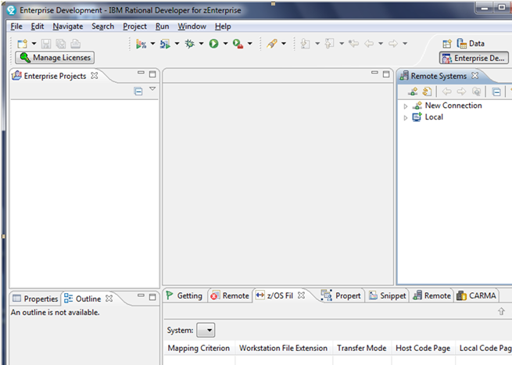

 Install Verification Procedure – 4 of 4 (RDz Enterprise – or Rational Developer zEnterprise)
If you are using RDz Enterprise – version 8.5.1 – you will see an Enterprise Projects view and an Enterprise Development perspective
The "Enterprise Projects" view is functionally equivalent to the "z/OS Projects" view.
And the "Enterprise Development" perspective is the same as the "z/OS Projects" perspective.

Slide 37

Installation and Configuration Unit – Summary
Close RDz – and do not save any changes to your source file
After having completed the steps in this unit, you should have successfully:
Installed and configured RDz
Verified the installation by:
  Creating your first local COBOL project
  Opening a file into the editor
  Exiting RDz

Slide 38
RDz Workstation Product and Course Setup
UNIT
Topics:
How to take this course
Installing RDz and Setting up for the Course
Installing IBM Data Studio for the course (Optional)
Install Verification Procedure
Accessing your mainframe resources
About Rational Developer for System z

Slide 39
Topic objectives
After completing this topic, you should be able to:
  Successfully install and configure IBM v4.1 shell-shared with RDz v9.0
 Important Notes
  This step is optional. It installs additional DB2/SQL functionality into the RDz Workbench from a free client product named: IBM Data Studio (formerly “Optim Data Studio”)
  The benefits of installing this package include:
    Superior DB2 data management tooling
    Superior SQL development tooling
    Test data/table subsetting functionality – for modifying the contents of large test tables
    Visual Explain

Slide 40
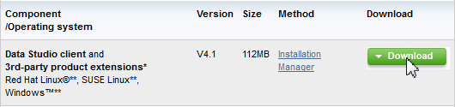
 IBM Data Studio Installation Process – 1 of 7
Open a browser, and point it at:
    http://www.ibm.com/developerworks/downloads/im/data/
    From the Download tab – click: Download
  At the Rational Developer for System z Trial page, you will either have to:
    Login to IBM's DeveloperWorks …or… Register for IBM DeveloperWorks, and then login
  When you have logged in, you will see a summary page, where you'll have enter a few additional pieces of information about your interest in RDz – and privacy settings.
  You'll have to accept the license agreement
  Click I confirm to continue
Note: If you’re using Internet Explorer (I.E.) and having difficulty navigating try using Firefox or Chrome

Slide 41
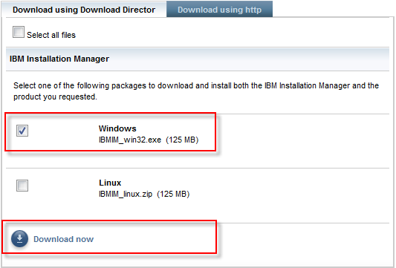
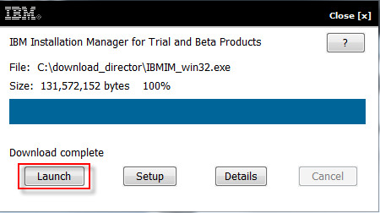
 Installation Process – 2 of 7
From the next web page:
Scroll and select Windows
- Click Download now
After the download is complete click Launch
You may be prompted to login to DeveloperWorks again

Slide 42
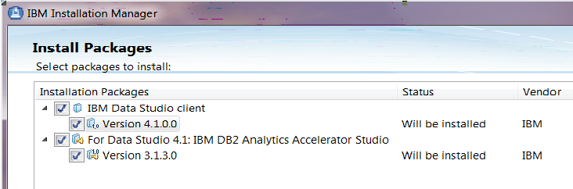
 Installation Process – 3 of 7
From Install Packages
  Make sure the IBM Data Studio client and DB2 Analytics Accelerator Studio packages are checked
  Click Next >
You will be asked to accept the terms of the license agreements
  Do so
  Click Next >

Slide 43
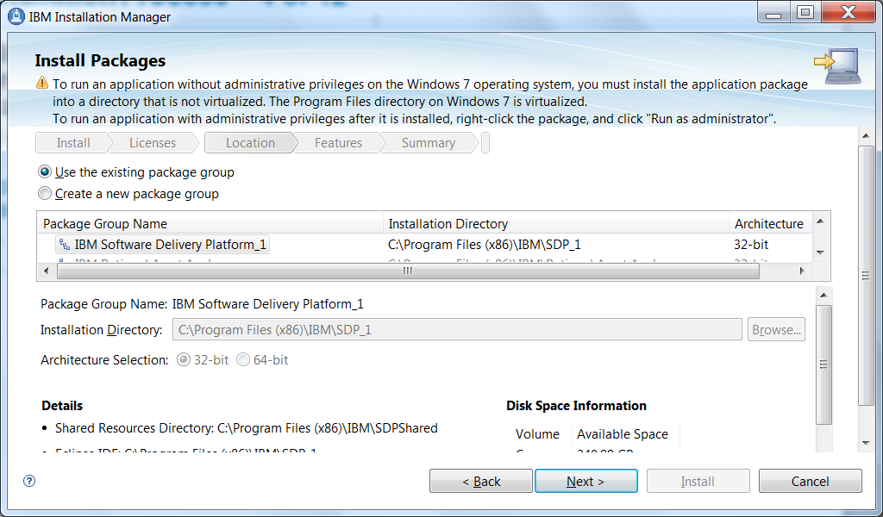
 Installation Process – 4 of 7
As in the RDz product install, you will need to designate a directory for the IBM Data Studio installation. To “shell-share” with RDz, select the same Installation Directory as your RDz v9.0 install (note that Installation Manager may do this for you automatically)
Click: Next >

Slide 44
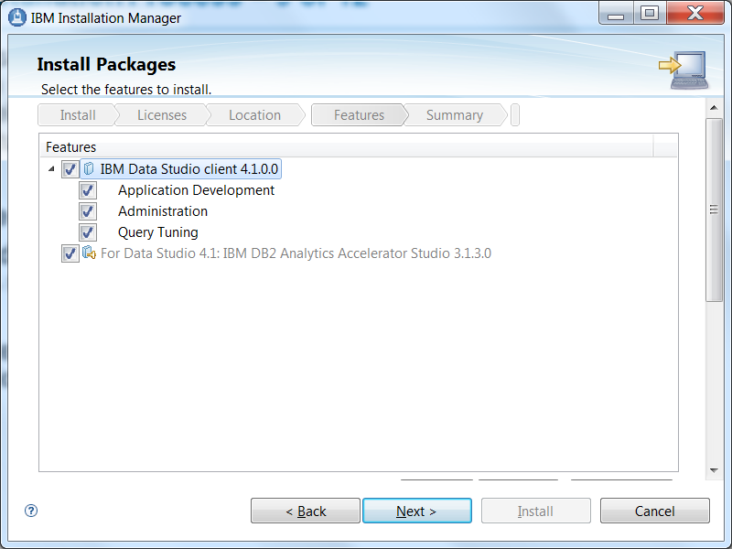
 Installation Process – 5 of 7
At this point in the wizard you can select more (lower-level) specific product features to install.
Click Next >

Slide 45
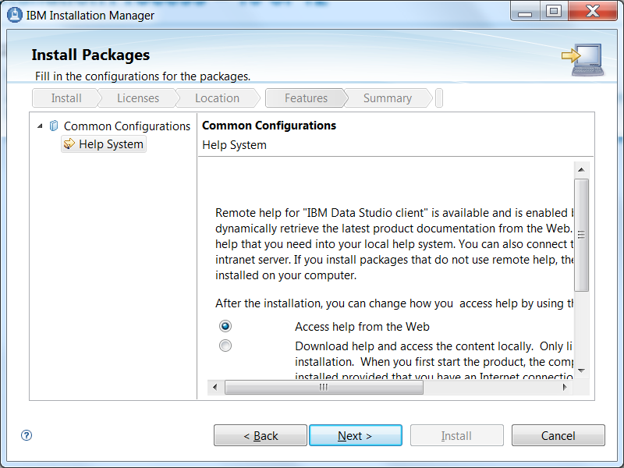
 Installation Process – 6 of 7
Choose where to install the product’s Help system
Choose:  Access help from the Web
Click Next >

Slide 46
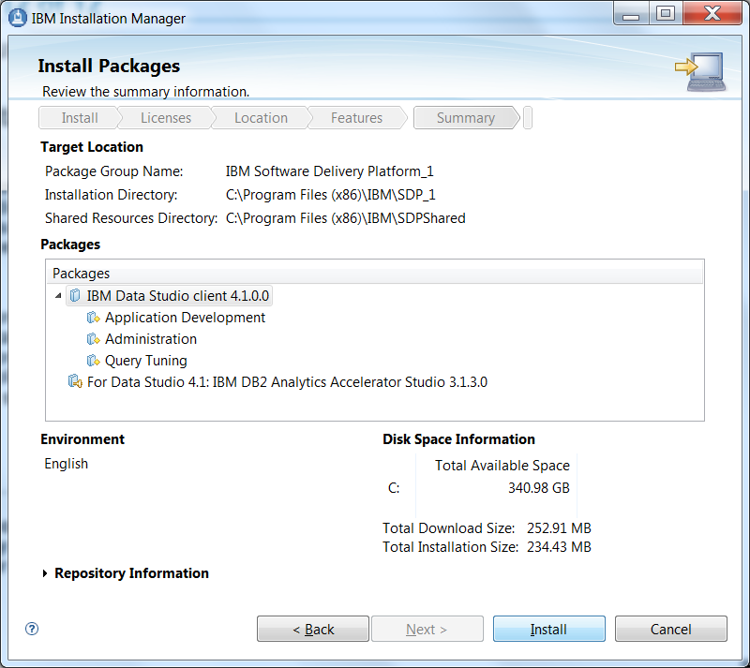
 Installation Process – 7 of 7
At this summary page
Click Install
The install could take up to an hour (depending on your PC's processor and disk read/write speed)
When installation is finished close the wizard and verify the installation by starting RDz
We recommend that make a copy of the launch icon for RDz (not Data Studio) on your desktop
If you had difficulty with the trial installation, please go here:
  http://www.ibm.com/developerworks/downloads/r/rdz/support.html
  … where you can obtain technical support from IBM

Slide 47
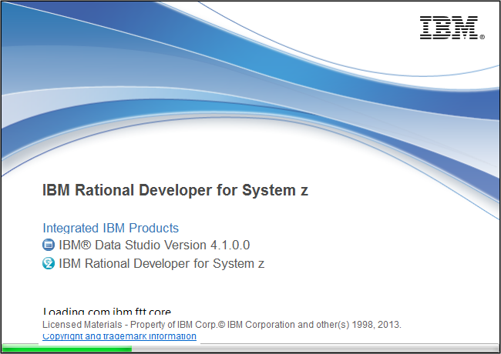
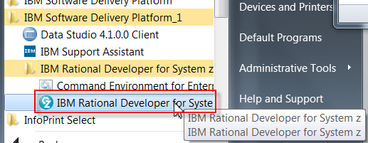
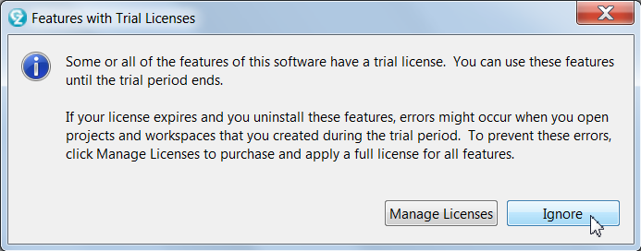
Launching RDz with IBM Data Studio
When you launch RDz shell-sharing IBM Data Studio you will see something like ➔
Ignore the licensing prompt (you have 90 days)
We recommend that make a copy of the launch icon for RDz (not Data Studio) on your desktop

Slide 48
RDz Workstation Product and Course Setup
UNIT
Topics:
How to take this course
Installing RDz and Setting up for the Course
Installing IBM Data Studio for the course (Optional)
Install Verification Procedure
Accessing your mainframe resources
About Rational Developer for System z

Slide 49
Topic objectives
After completing this topic, you should be able to:
  Successfully setup your mainframe libraries for RDz Distance Learning class
  Copy the correct programs, datasets and files from this PowerPoint slide deck to your libraries in anticipation of the class
  Understand the different workshop alternatives you'll have for RDz class

Slide 50
Connecting to a Mainframe in this class – Plans "A", "B" and "C"
Plan A - If you are learning RDz using your company's mainframe computing center, and if they have successfully installed and configured the RDz mainframe server components:
  Contact your shop's Systems Programmer staff and get the host-name and port#s for connecting to your z/OS machine
  Return in this section to the slides and steps that describe how to create the following resources used in the workshops: see slide titled: Mainframe Resources – 1 of 2
    Libraries
    Members in the libraries
    Sequential datasets
  Follow the steps to create the resources you will use in your shop
  Note that typically only one person will need to do this administrative process
If your shop does not have the RDz mainframe server components installed you can use Plan B
Plan B - If you are intending to access the IBM zServerOS mainframe directly – not through the Sandbox you will have to ensure that:
    You will need access to an IBM mainframe with the URL: zserveros.demos.ibm.com Unfortunately, you can't ping this URL, but you'll find out if you can access it when you attempt to test your connection. The slides to create and test a connection follow.
    You'll also need access to the following Port from your PC or workstation: 4035
    If you are working from a home computer, most likely you'll be able to do access zServerOS. But if you are working from an office machine, you should check with your I/T personnel to ensure that you have access to the above remote IP address and the Port#s.
    You will need a TSO ID. You can obtain one by contacting: jsayles@us.ibm.com

Slide 51
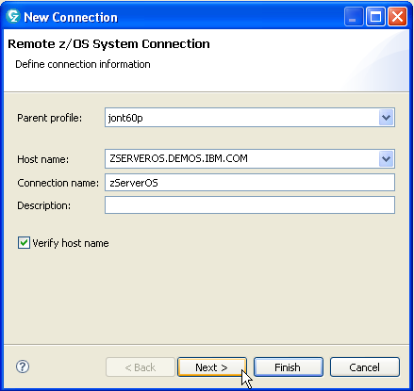
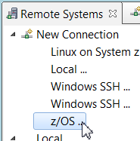
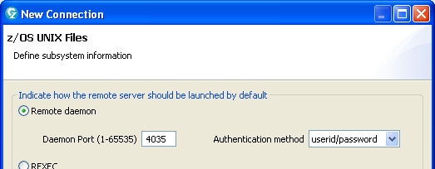
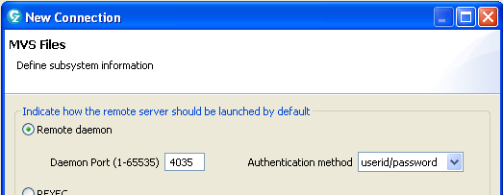
Plan C – Accessing the IBM zServerOS – Screen Captures
Here are the z/OS Connection screen values you can use to create a new zserveros connection.
  Host name (IP address):
    zserveros.demos.ibm.com
  Ports for z/OS and MVS Files
    4035
Note that these are all the wizard defaults
Note that zserveros.demos.ibm.com is not a ping-able I/P address.
However, you should be able to connect to it unless:
Your shop has firewall restrictions
You do not have access to port 4035

Slide 52
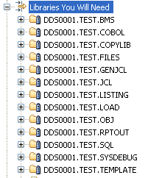
 Mainframe Resources – Create Libraries
1. Allocate the following libraries on your mainframe, with enough space for at least 20 members:
  LRECL: 80
  DSORG: PO
  RECFM: FB
    <High-Level Qualifier>.TEST.BMS
    <High-Level Qualifier>.TEST.COBOL
    <High-Level Qualifier>.TEST.COPYLIB
    <High-Level Qualifier>.TEST.FILES
    <High-Level Qualifier>.TEST.GENJCL
    <High-Level Qualifier>.TEST.JCL
    <High-Level Qualifier>.TEST.OBJ
    <High-Level Qualifier>.TEST.SQL
    <High-Level Qualifier>.TEST.TEMPLATE
  LRECL: 133
  DSORG: PO
  RECFM: FB
    <High-Level Qualifier>.TEST.RPTOUT
    <High-Level Qualifier>.TEST.LISTING
    <High-Level Qualifier>.TEST.SYSDEBUG
  LRECL: 0
  DSORG: PO
  RECFM: U
    <High-Level Qualifier>.TEST.LOAD
<High-Level Qualifier> ➔ your TSO ID

Slide 53
RDz Introduction
UNIT
Topics:
How to take this course
Installing RDz and Setting up for the Course
Install Verification Procedure
Accessing your Mainframe resources
About Rational Developer for System z

Slide 54
Topic objectives
After completing this topic, you should be able to:
  Describe the major areas of RDz enablement
  Define the difference between local and remote RDz projects
  List at least two of the leading-edge COBOL features/functions RDz provides tooling for
  List a few of the IBM mainframe technologies that you can work on with RDz, in either local or remote project modality
 Note that, if you’re not a mainframe developer, and the z/OS acronyms introduced in this section seem a bit daunting, not to worry. We will be covering them in the days ahead – or if you're learning self-paced when you get to the z/OS unit – and defining terms, concepts, features and programming constructs.

Slide 55
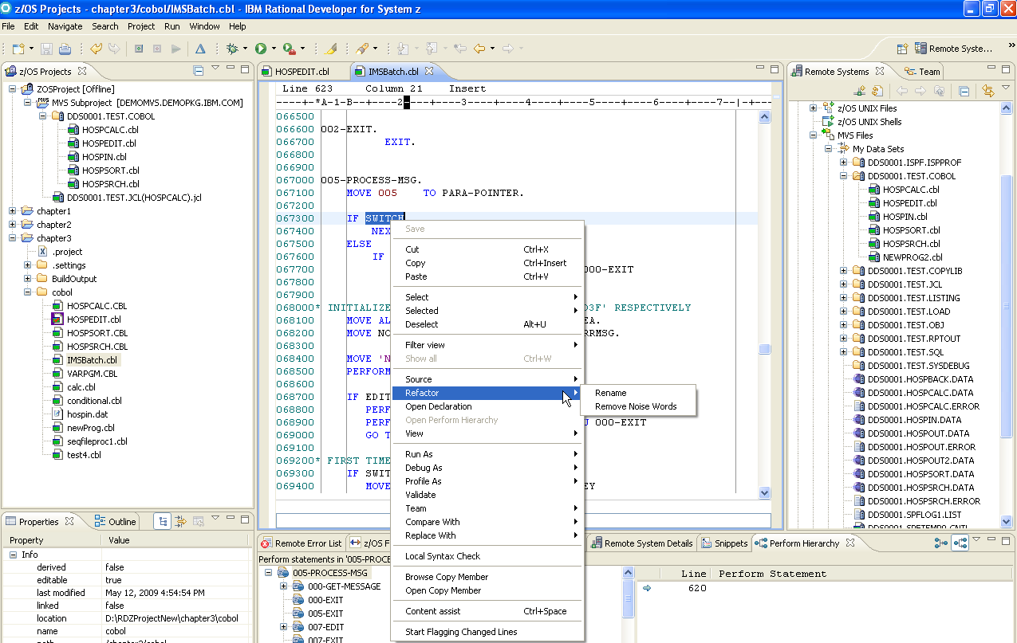
What is Rational Developer for System z ?
IBM’s Application Development Workbench for the 21st Century
RDz provides a workstation-based environment with advanced, graphical-tool-based access to z/OS data sets and z/OS resources.

Slide 56
What Can You Do with Rational Developer for System z ?
With RDz you can:
  Develop mainframe applications in:
    COBOL
    PL/I
    HLASM (high-level assembler language)
  Target code you write for run, test/debug:
    z/OS Batch
    z/OS online applications running CICS or IMS TM
    z/OS with access to: DB2, IMS (DL/I), QSAM, VSAM data structures
    Windows-based systems
      This feature is deprecated, unless you are using Windows XP
RDz enables:
  z/OS traditional mainframe coding and testing
  Integration with leading-edge z/OS development tools and features
  Template-based development
  Integration with modern languages and toolsets

Slide 57
RDz Traditional Development Features and Facilities – Where Do You Develop?
z/OS application development can be accomplished using one of two development models:
  Workstation-based offloaded development:
    Analyze, Edit, Syntax Check with integrated, graphical development tools and a sophisticated Integrated Development Environment (IDE)
    BMS and MFS map “painting” facilities
    Develop and test Web Services
  Workstation-based remote z/OS development and test:
    Edit, Compile, Unit Test, Integration/Systems Test, Resolve z/OS application ABENDs (defects) – with the same integrated, graphical tools and IDE
    Drag & Drop between mainframe and PC and between mainframe LPARs
    Applications tested on the host and debugged using z/OS datasets and databases
    Workstation-based, graphical tools for z/OS dataset management
    TSO command line, and ISPF (host) emulator sessions
    Integration with all major Source Control Management systems
    Graphical tools access to JES and job queues
    Access to Unix System Services
You can swap from Workstation-based to remote at any time. The next slide describes many of the development configurations and application resources supported by RDz.

Slide 58





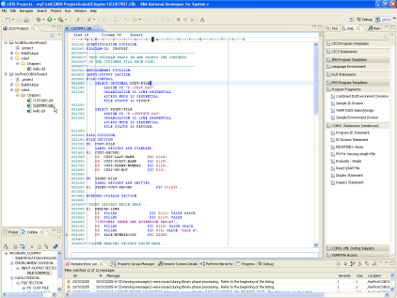

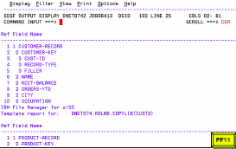
RDz Development Options – Local and Remote
Using RDz you can work:
Locally – on your PC
Remote – connected to z/OS, with
access to the resources
shown here ➔
CICS Screens
MFS Screens
Fault Analyzer
TSO/ISPF
Web
Job queues
and JES
Subsystem
z/OS Mainframe System
Web
Services
Source Control Management
COBOL
PL/I
Assembler
______ Remote Development and Test ______
PDS/PDSE
Datasets
RDz Workbench
DB2/Z
Data
QSAM
Datasets
Local Projects
UDB
VSAM
Datasets
DL/I Database
Local Development
File Manager
Notes:
Note that, if you’re not a mainframe developer, and all of those acronyms seem a bit daunting, not to worry. We will be covering them in the days ahead – and defining terms, concepts, features and programming constructs.

Slide 59
IBM Rational Developer for System z version – a BIG PRODUCT
XML Services for the Enterprise
- SOA support for COBOL or PL/I using CICS or IMS
Bottom-up/Top-down or meet-in-the-middle COBOL/PLI to XML mapping support
meet-in-the-middle development scenario tooling wizards. for CICS, IMS, and batch applications
IBM Rational Developer
for System z
z/OS Application Development
Work with z/OS resources like COBOL,
PL/I , C, C++, JCL, etc.
Interact with the Job Entry Subsystem (JES) to submit jobs, monitor jobs, and review job output
Perform dataset management actions
Perform typical edit, compile, and debug tasks on remote z/OS resources from the workstation
z/OS Application Development
XML Services for the Enterprise
CICS Service Flow support
Supports CICS Service Flow Feature
Wizards to build service flows out of your existing COMMAREA WSDL and Terminal based CICS applications.
DB2 Stored Procedure for COBOL and PL/I
Create DB2 stored procedures on z/OS in either COBOL or PL/I
Build and catalog support for the DB2 stored procedure
Debug z/OS based stored procedures from workstation
CICS Service Flow support
CICS BMS/IMS MFS Map Support
CICS BMS/ IMS MFS Map Support
Visually create and modify BMS Map sets or IMS/MFS
Generates JCL
Work with local or remote maps
DB2 Stored Proc for COBOL - PL/I
z/OS Tooling Integration
Read/Write/Update VSAM datasets via integration with IBM File Manager
Access IBM Fault analyzer reports for analyzing ABENDS and associating back to source code
DB2 App Generator wizard
z/OS Tooling Integration
DB2 App Generator wizard
Generate WSDL, JCL and CICS COBOL program to access DB2
Generate CRUD programs code from existing DB2 table, which can also be integrated into web service applications
VSAM App Generator wizard
VSAM App Generator wizard
Generate JCL , BATCH or CICS COBOL program skeletons to access VSAM/QSAM
UML to COBOL Transformation(*)
UML to COBOL Transformation(*)
Provide UML assets in order to represent COBOL in UML (Models, Profiles, Patterns)
UML transformations generate models more specific to COBOL target
Final transformation generates COBOL source
Rational Application Developer or Rational Business Developer
Core functions
Other functions

Slide 60
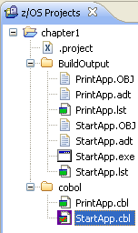
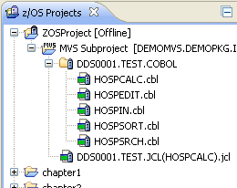
More About RDz's Local and Remote Projects
In RDz a project is a collection of related resources (source files and executables) that are organized in a hierarchical folder-set – of your design
  If you’re a mainframe developer, think of a folder as similar to a TSO library (PDS/PDSE) and the individual files in a project folder as members in the PDS
In RDz your projects can be organized (and stored) locally – on your PC. These are called z/OS Projects ➔
  And using RDz you can edit, compile (locally), run and debug
RDz also supports remote projects – Known as "MVS SubProjects”
Remote projects are z/OS files, accessed from RDz via a remote explorer and presented graphically like local projects
RDz allows you to edit, compile/link (on the mainframe), run and debug on the mainframe – remotely – as well as allocate mainframe datasets, copy and move files, sync versions, upload and download files, move files between LPARs, etc.
This allows you to get the benefits of RDz’s exceptional tools and technology, without having to offload (transform, download and convert) source and data files
As shown, "Remote Projects" can be Offline - Only active on your workstation or Online and synchronized with z/OS. By working offline you save additional z/OS resources without sacrificing any development functionality.

Slide 61

Why RDz?
Provides a common IDE for:
  Traditional mainframe development
  Leading-edge mainframe development
  Cross-platform development for:
    COBOL, PL/I and assembler programmers
    Java developers
    Web services projects
    Web 1.0 and Web 2.0 developers
Provides an integrated set of tools that support end-to-end application development – from analysis, to editing, unit test, integration test and deployment of applications
Offers easy-to-use graphical tool functionality
  Ask yourself – when was the last time you opted for DOS commands on your PC as opposed to dragging and dropping with Windows functionality?
Allows remote interactive testing, debugging, and deployment of CICS and IMS/TM applications, and batch debugging of COBOL, PL/I, and assembler applications
Use integrated graphical tools to do mainframe work:
  Submit and monitor jobs
  Issue TSO commands, CLISTs, and REXX EXECs and access ISPF through host emulation
  Allocate files
  Edit mainframe test data: DB2, QSAM and VSAM files (with IBM File Manager), IMS Databases (with the IMS Universal Driver)
Net: RDz breaks the barriers inherent in 3270 (green-screen) development tools
Web 1.0
Web 2.0

Slide 62


Why RDz?
Same basic functionality over the past 35+ years
With RDz…………
See more
Do more
Work much more productively
Save time and money

Slide 63

Traditional Mainframe Development Using TSO/ISPF
Multiple, separate tools, and a development platform limited by the technologies created during the Gerald Ford administration (or the year that Barbara Streisand's "The Way we Were" was the #1 Billboard hit)
submit compile job
swap to SDSF
select job
edit JCL
find error msg
find code line (remember error)
exit source
change code
swap to edit session
find code line
edit source
exit JCL

Slide 64

RDz Integrated Tools – Edit/Check/Compile/Debug/Run
Edit Source
Syntax Check
Double-click Syntax Error
(positions cursor on error line)
Notes:
With the z/OS Application Development support provided in RDz, the developer now makes changes in the editor, does a syntax check, double-clicks on any error and is positioned at the source statement in error. The developer can make the appropriate changes, save and syntax check, submit the JCL to compile the program, and check the results, all with a few clicks of a mouse. The development process has been simplified.

Slide 65

RDz Integrated Tools – Remote Debug
Run application on the host:
  From CICS, IMS TM, PROCs or run-stream JCL accessing z/OS-based testing datasets and databases
Debug program using RDz integrated, graphical tools

Slide 66

Integrated CICS/BMS – IMS TM/MFS Map Editor
For both CICS/BMS and IMS/MFS:
  Graphical editing
  Source-mode editing
  Preview
    Run-time simulation
Notes:
The Basic Mapping Services (BMS) map editor provides a design canvas that lets you quickly create and edit CICS BMS maps, and then lets you generate the JCL to compile the maps.

Slide 67

Integrated DB2 Relational DBMS Table Editor
Full-screen test data editing facility
SQL statement: Editor, Query build facility, Test
Create, deploy and test DB2 Stored Procedures

Slide 68
Leading-Edge COBOL Development Features
Integration with a bevy of leading-edge z/OS development tools and features:
  Web Service – create and consume
  DB2 Stored Procedures – create, test, deploy
  XML-COBOL – development and testing
  CICS and IMS TM SOA Aggregation – Service Flow Modeler
  IBM Problem Determination Tools – Fault Analyzer, Debug Tool, File Manager
  QSAM/VSAM/DL/I database/DB2 table/test-data browse and edit
Template-based development:
  Program-level Coding Patterns
  Application-level Frameworks
Integration with other modern languages and toolsets:
  Java applications
  Web 1.0 applications
  Web 2.0 applications

Slide 69

CICS and IMS TM COBOL and PL/I Web services
Wizards for enabling Enterprise SOA assets from CICS COMMAREA, and IMS IO-PCB masks.
RDz
Maps and
Generates
COMMAREA
IO-PCB
COBOL
PL/I module

Slide 70

VSAM or DB2 Application Generator
Wizards for creating CRUD (Create/Read/Update/Delete) COBOL application frameworks – for both VSAM and DB2 data sources
UML Model
Data
Base
VSAM
Files
Note that this RDz feature is not covered in class

Slide 71

Service Flow Modeler
Service Flow Modeler is a feature that allows you to aggregate existing CICS applications into composed business services, which may be integrated into a SOA environment
Note that this RDz feature is not covered in class
…or later

Slide 72

COBOL and PL/I Stored Procedures
Create, Explain (analyze performance), Test and Deploy Stored Procedures
Note that this RDz feature is not covered in class

Slide 73


Enterprise Generation Language (EGL) COBOL Generation
High-level programming language for developing leading-edge business applications
  Web 1.0 – J2EE/Java
  Web 2.0 – JavaScript/AJAX
Independent of implementation
  Hides technology complexities
  Presentation and persistence layer API fully generated
Enables Rapid Application Development
Simplifies development of Services
Run-time code generated for appropriate platform
  Java and JavaScript for Windows, Linux, System I, etc.
  COBOL for System z and/or System i
Development and Generating Tools included with Rational Business Developer (RBD) – if using RDz with EGL
Migration path for Cross System Product (CSP), Visual Age Generator, and Informix 4GL customers
iPhone – Web 2.0 application
WebSphere Application
Server
IBM z/10 series
COBOL
CICS
Application
COBOL Wrapper
Generated by RDz
WSDL
DB2
Database
Note that this RDz feature is not covered in class

Slide 74
RDz and COBOL
In this class we will focus initially and primarily on local COBOL development using RDz installed on your personal computer:
  Teaching as much of the language as possible using RDz local projects.
  This includes:
    The foundation COBOL language and Language Environment (LE) functionality
    SQL and accessing DB2 (relational) data
    CICS and running local online applications using IBM’s TX-Series product
  Then, moving up to the mainframe, for work that is best learned on the deployment platform you’ll be running your labs on:
    Mainframe z/OS
    Using JCL, running and working with jobs and job queues
    And accessing IMS TM – DL/I and online screens using MFS
      Note – if you're interested in IMS TM, here is a current best-in-class manuscript:
        http://www.ibmpressbooks.com/articles/article.asp?p=377307&seqNum=2

Slide 75
RDz and Advanced COBOL Development Techniques and Technologies
There are a number of optional RDz topics you can learn about
Some will be presented at the end of this course; others are available through additional IBM education venues:
  The Enterprise Modernization Sandbox
    http://www.ibm.com/developerworks/downloads/emsandbox/systemz/assets/
  White papers published in DeveloperWorks
    http://www.ibm.com/developerworks/
  Classes from Rational Education
    http://www-01.ibm.com/software/rational/education/
Advanced COBOL development techniques and technologies, they include:
  COBOL and Service Oriented Architecture (SOA)
    Creating and consuming Web Service Definition Language (WSDL) files as interfaces into existing CICS and IMS COBOL mainframe functionality
  COBOL and DB2 Stored Procedure creation
    Creating, deploying and testing DB2 Stored Procedures using a wizard-driven approach
  COBOL and XML data access and manipulation
    Reading (parsing) and writing XML files in COBOL
  Template-ized COBOL database and file application generation
    Using UML and wizards to build COBOL applications declaratively

Slide 76
RDz – Ancillary Study Materials
IBM has set up a large number of sites with quality learning content surrounding Rational Developer for System z:
RDz IBM product web page:
  http://www-01.ibm.com/software/awdtools/rdz/
RDz productivity study:
  http://publib.boulder.ibm.com/infocenter/ieduasst/rtnv1r0/index.jsp
RDz recorded demos (click on Rational Developer for z)
  http://publib.boulder.ibm.com/infocenter/ieduasst/rtnv1r0/index.jsp
RDz manuals and redbooks:
  http://www-01.ibm.com/software/awdtools/rdz/library/index.html
About System z mainframes:
  http://publib.boulder.ibm.com/infocenter/zos/basics/index.jsp?topic=/com.ibm.zos.zconcepts/zconcepts_166.htm
  http://w3.democentral.ibm.com/wps/portal/systemz
  http://www.ibmsystemsmag.com/mainframe/index.aspx
  http://www-03.ibm.com/systems/z/destinationz/

Slide 77
About RDz Development – Summary
After having completed this topic, you should now be able to:
  Describe the major areas of RDz enablement
  Define the difference between local and remote RDz projects
  List at least two of the leading-edge COBOL features/functions for which RDz provides tooling

